Slide 1
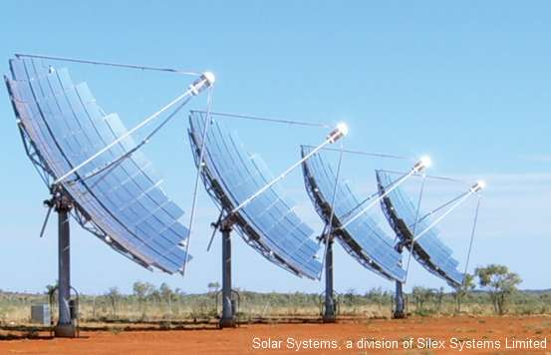
III-Sb CPV solar cells
© J.Tournet – May 2016
E. Tournie, Y. Rouillard

Slide 2
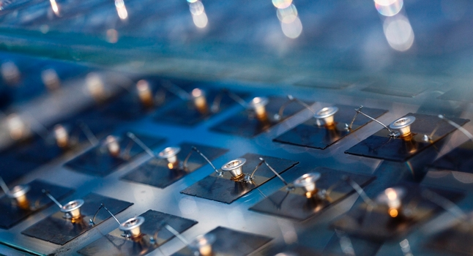
Outline
III-Sb cells
AlInAsSb
Conclusion & outlook
Soitec
CPV systems
1

Slide 3
III-Sb solar cells
2

Slide 4
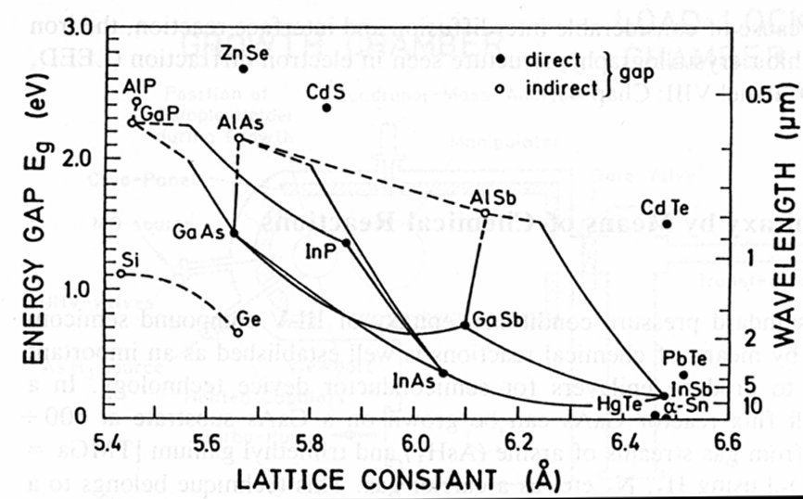
Interest for III-Sb compounds:
Adapted from: France et al, MRS bulletin March 2016
4J cells
3J cells
2J cells
3

Slide 5
AlInAsSb growth
& characterization
4

Slide 6
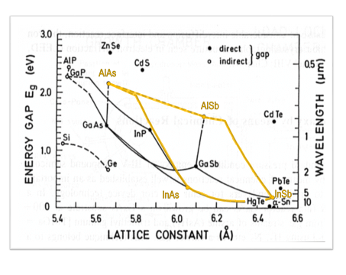
AlInAsSb for MJ cells
1.65eV
1.25eV
0.77
0.35
Cell type | Compo | E_{g} (V)
Tandem on GaSb | Al_{0.65}In_{0.35}As_{0.35}Sb_{0.65} | 1.45
Tandem on Si | Al_{0.75}In_{0.25}As_{0.19}Sb_{0.81} | 1.69
3J on GaSb Middle cell Top cell | Al_{0.53}In_{0.47}As_{0.45}Sb_{0.55} Al_{0.75}In_{0.25}As_{0.27}Sb_{0.73} | 1.21 1.68
Energies of the lowest direct E₀ and indirect gaps E_{g}^{ID} versus x for
Al_{x}In_{1-x}As_{y}Sb_{1-y}/GaSb and Al_{x}Ga_{1-x}As_{y}Sb_{1-y}/GaSb.
Sadao Adachi, 2009, Properties of semiconductor alloys, John Wiley & Sons, Ltd
Design by Y.Rouillard

Slide 7
GaSb cap @ 400°
AlSb PL @ 400°
AlInAsSb @ 400° Sb opening #2
AlInAsSb @ 400° Sb opening #1
AlSb PL @ 400°
GaSb substrate + buffer
50nm
Growth strategy
20nm
50nm
Challenges:
Important miscibility gap for $x_{Al} ε \left[0,07;1\right]$
Phase separation
Variations in composition with $T_{sub}$
Exact composition knowledge
50nm
20nm
∞
G R O W T H S R E C A P
Essai bulk + DA
Lattice matching
01-02/2016
V2450-V2466
Essais
Compo - PL
10/2015
V2398
V2400
11/2015
Vanne As
12/2015 – 01/2016
V2428-V2448
Al_{0,53}In_{0,47}As_{0,43}Sb_{0,57}
Al_{0,70}In_{0,30}As_{0,30}Sb_{0,70}
Al_{0,25}In_{0,75}As_{0,68}Sb_{0,32}
Al_{0,75}In_{0,25}As_{0,26}Sb_{0,74}
Al_{0,60}In_{0,40}As_{0,39}Sb_{0,61}
6

Slide 8
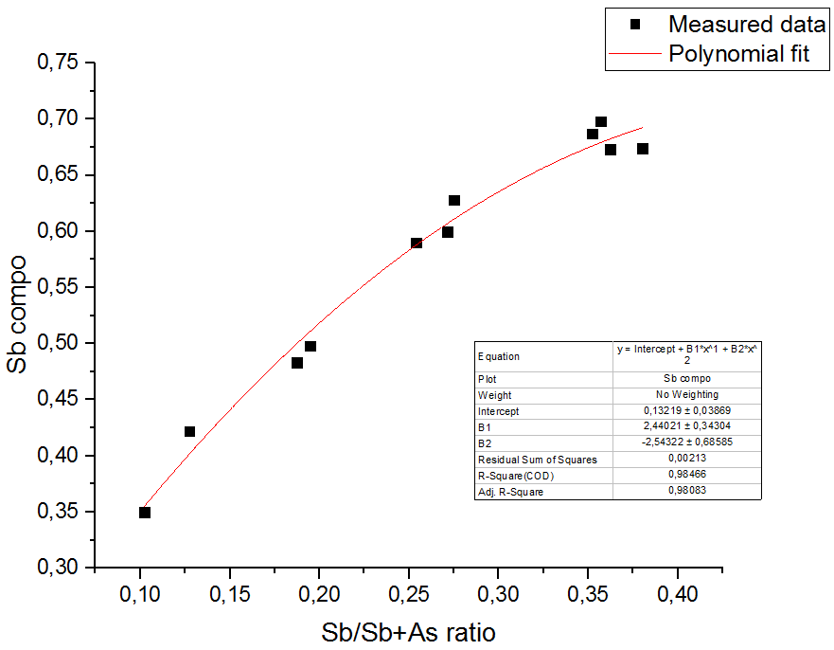
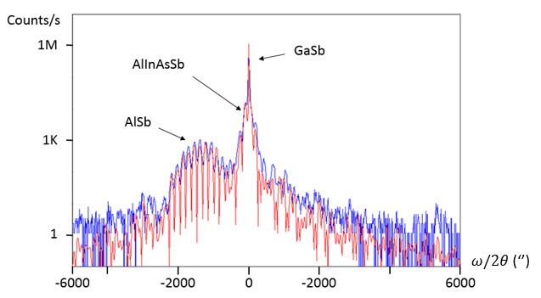
Results
Experimental details:
Random alloys grown at $T_{sub}=400−430°C$
Test both bulk and DA
Rate 1ML/s
Capped with GaSb (impact on PL)
Characterization:
Lattice-matching evidenced by HRXRD
RMS roughness:
400°C: 0,2-0,3 nm
430°C: 0,4-0,6 nm
7

Slide 9
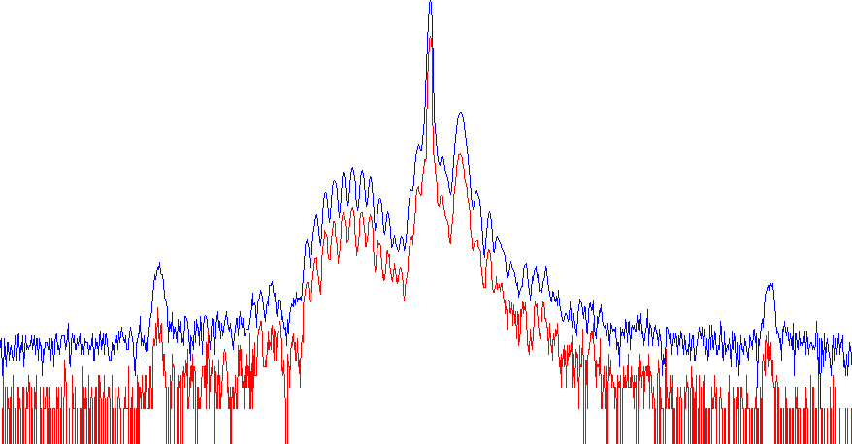
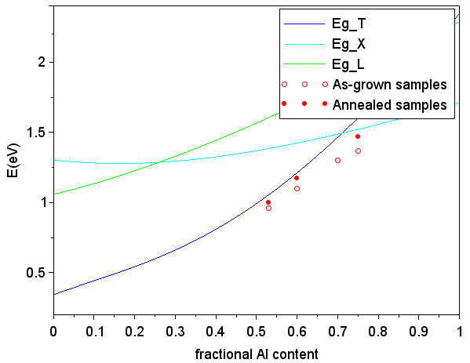
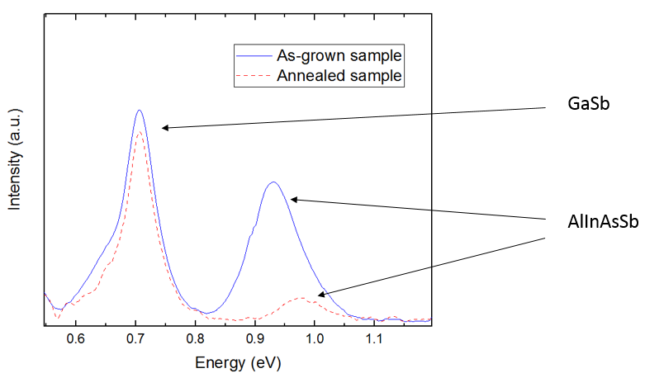
Effect of annealing
1h
$$T_{anneal}=475°C$$
AlInAsSb annealed
XRD unchanged
No phase decomposition
No compositional variation
PL shifted towards higher energy
AlInAsSb not annealed
70K PL
8

Slide 10
Conclusion
& perspectives
9

Slide 11
Summary
Success in reproducible AlInAsSb epitaxy for various compositions
Confrontation of AlInAsSb band gap energy observations to simulation
Observation of the effect of annealing on the material
10

Slide 12
Outlook
Improve material quality of AlInAsSb
TEM study of AlInAsSb samples grown at different temperatures
Investigation of tunnel junctions and processing steps
Use of annealing effect to grow 2J and 3J cells
11

Slide 13
Thank you for your attention!
Questions are welcome…

